Slide 1
Hypothesis Testing
Day 4
2016

Slide 2
Contents
Introduction to Hypothesis Testing
Approach to Hypothesis Testing
One tail and two tailed tests
Z test
t test

Slide 3
Notes:
Testing of hypothesis is about providing evidence to support hypothesis
Innocent until proven guilty
Ask a question and give examples – Someone makes a extravagant claim – he has to provide enough evidence to support

Slide 4
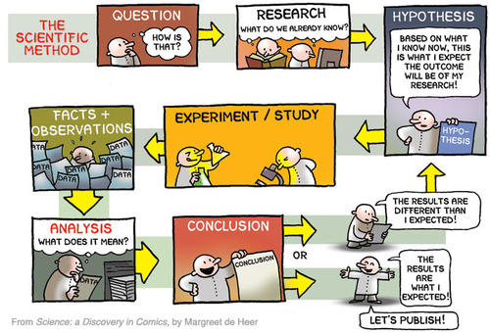
The scientific method
Notes:
Specify the hypothesis
State tolerance for error
Collect data
Calculate a probability

Slide 5
Motivation for testing hypothesis
The intent of hypothesis testing is to formally examine two opposing conjectures (hypotheses) H₀ and H₁
H₀ is referred to as the null hypothesis which can be your status quo
H₁ is the alternative hypothesis – which has been put up against the null hypothesis
These two hypotheses are mutually exclusive so that one is true to the exclusion of the other
It is important to remember that hypotheses are always statements about the population or distribution under study, not statements about the sample
The hypotheses may result from past experiences or knowledge of the process or even from previous experiments
Notes:
Apart from the above, we specify the tolerance for errors [This is specified before testing the hypothesis not after]

Slide 6
A test of hypothesis is a procedure leading to a decision
Hypothesis testing procedures rely on using information in a random sample from population of interest
If the information is consistent with the hypothesis, we will conclude that the hypothesis is true
However, if this information is inconsistent, we will conclude that the hypothesis is false
Truth or falsity of a particular hypothesis can never be known with certainty, unless we can examine the entire population
Notes:
Probability of observing data as extreme as it were in the direction of the alternate
What does it mean for p-value to be high? Low? Ask the question
Give examples about what this means and illustrate the null and alternate hyp distributions on the board
Assumption of average age of Mu Sigma is 90! Collected data shows 23, 24, 25, …. Evidence is away from the assumption hence assumption seems wrong

Slide 7
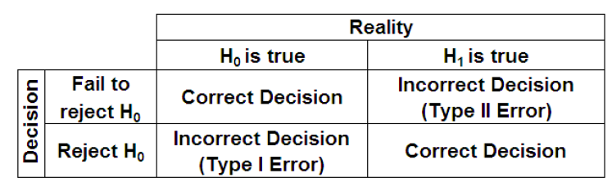
Any decision making process is in danger of errors
Two kinds of errors exist in any decision making process
Rejecting the null hypothesis (H₀) when it is true is defined as Type I error (α)
Failing to reject the null hypothesis when it is false, is defined as Type II error (β)
Notes:
Talk about the fact even if the chance of the data being generated based on the null hyp assumption is less, the chance is still there.
There fore there is a chance of making an error
What are the types of error one can make?
Type 1
Type 2
Decision rule is to compare the p-value with my tolerance for error and accordingly
Ask what the relationship between errors is? Discuss which errors are more dangerous?

Slide 8




Case Study: What are the chances of putting an innocent prisoner
behind bars?
So what does putting prisoners in trial have to do with hypothesis testing?
A Type I error is when you reject Ho when actually it is correct
Type 1 error is like putting an innocent person behind the bars.
Type 1 error occurs when null hypothesis is rejected but it is true
A Type II error is when you accept H0 When it is actually
wrong
If you get a type I error , your test statistic must be here in the critical region
Type 2 error would result in letting a guilty person go innocent
-2
-1
0
1
2

Slide 9
Mr. X claims that he is able to distinguish between Diet Coke and Coke
To test this claim, 8 cups were offered to him to taste and make a decision
In each cup, there would be either coke or diet coke - which Mr. X would have to guess after tasting
If Mr. X is able to guess 6 out of 8 cups - can we say Mr. X has the ability to distinguish between the two types of drinks?
What is the procedure to test the claim?
Notes:
Ask and discuss
What would you say?
What is the null? What is the alternate? Greater than, less than and not equal to
What does less than and not equal to 0.5 mean? Does it make sense?
What’s the error you are okay with?
Translating the English hypothesis to a mathematical hypothesis
Other examples of testing hypothesis:
Running a campaign would be a one sided hypothesis test

Slide 10
The underlying probability distribution in this example is Binomial with 8 trials and probability of success θ
The probability of k successes in 8 trials is given by
where θ is the probability of correctly making a guess
Notes:
Revisit binomial distribution
Hypothesis translates to binomial distribution

Slide 11
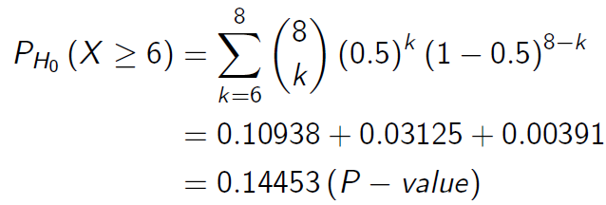
We evaluate the chance of observing the data obtained under the null hypothesis
Our null hypothesis is H₀: θ = 0.5, i.e., Mr. X does not possess any ability to distinguish between Diet Coke and Coke
Alternative hypothesis being, H₁: θ > 0.5. We do not consider θ < 0.5, since it is not meaningful in this context
Moreover we would like our significance level to be at α = 0.05, i.e., we expect to make wrong decisions not more than 5% of the times
With the above assumptions, we calculate the chance of observing the data as extreme as it were (at least 6 successes out of 8 trials)

Slide 12
We reject our null hypothesis if our p-value is less than the significance level
Our test of null hypothesis is completely defined with the critical region for the test – i.e., the region of rejection
We would like to reject our null hypothesis at level α if
The critical point or region in this case is identified by the point k which satisfies the above equation
In our example, Mr. X has been able to guess six out of eight cups correctly
With a p-value of 0.14, the chance of getting six or more correct answers by simply guessing is too high to make us accept Mr. X’s claim
Hence in the light of the given data, we are unable to reject our null hypothesis θ = 0.5, i.e., Mr. X is simply guessing

Slide 13

A manufacturer claims, burning rate of a particular type of propellant is 50 cm/sec
If we wish to challenge such a claim, we frame our hypothesis as
Suppose the standard deviation of burning rate is σ = 2.5 cm/sec
To test the hypothesis, we draw a sample of n = 10 specimens and calculate the average burning rate
What is the critical region for the above test?

Slide 14


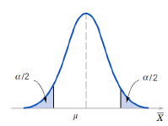

We assume that the burning rate has normal distribution
From the sampling distribution of the sample mean we obtain, the average burning rate
Our critical region for the test is defined as at the point Z_{α/2} such that
i.e., we find a point above which the probability is α/2
From the standard normal probability distribution table (μ = 0, σ = 1) we find for α = 0.05, Z_{α/2} is 1.96
We reject H₀ at 5% level if

Slide 15


Case Study: SnoreCull claims to cure snoring with a 90% success
rate
A doctor, well known in NYC for her skills to cure snoring is not convinced by the claim of the drug company and decides that she will conduct a test on 100 people
Here are the results
Is your snoring getting you down Then you need new Snorecull. The ultimate remedy for snoring.
SNORECULL cures 90%
of snores within 2 weeks
Cured | Yes | No
Frequency | 80 | 20
CULL THOSE SNORES WITH NEW SNORECULL
I’m not sure if the claims are true. Had they been, more of my patients would be cured

Slide 16




To conclusively say that the claims are false, we would need to
perform a hypothesis test
The claims of the drug company are false and people will continue to snore!!
It was a bad day for the doctor and the sample was biased. Those were the 100 best snorers NYC has !!
(-Also our Null Hypothesis)
Does that mean that the drug company is lying? Shouldn’t the drug have cured more patients ?
But can we really be certain that the drug company is at fault ? Maybe the doctor was unlucky.
Guys,you need to do a “Test of Hypothesis”.

Slide 17
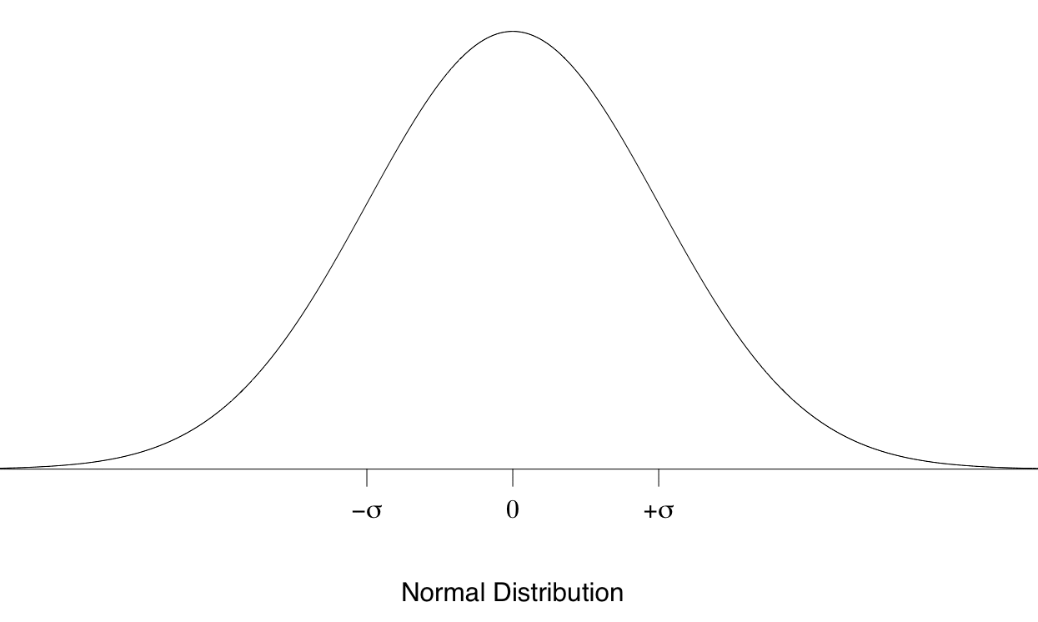
The relation between significance, critical and p-value
Fail to Reject Null Hypothesis
Significance Level(Margin of Error)
Critical Value
(Value corresponding to the Significance level)
p-value is the probability, that the observed values will be equal or more extreme than the critical value
Lower the p-value, stronger is the evidence against p-value

Slide 18
Hypothesis testing is the first and most essential part of statistical inference
Steps in Hypothesis Testing
Decide on the hypothesis you are going to test
The claim that we are putting on trial
Choose the test statistic
A method that best suits to test the claims
Determine the critical region
Level of certainty we are looking for, before we accept or reject the claim
Find the p-value of the test statistic
What is the probability of the null hypothesis being actually true
See whether the test result is within the critical region
Make decision

Slide 19



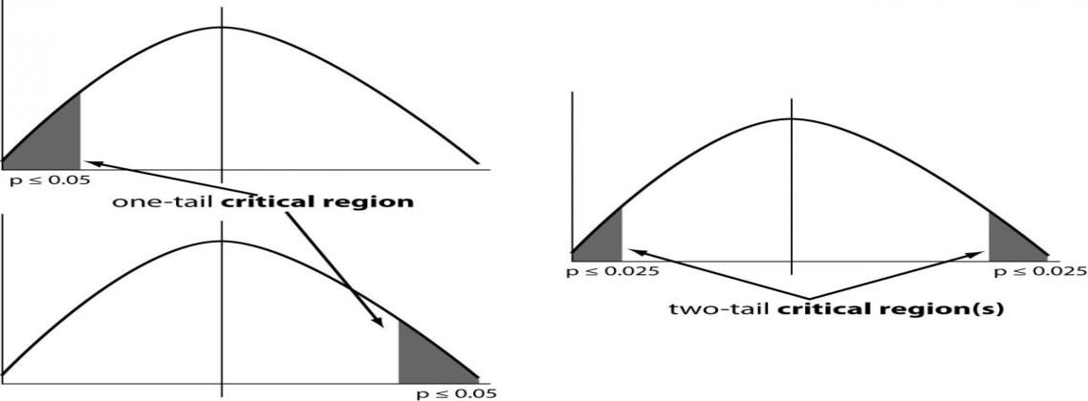
One tailed tests help in making specific guess unlike two tailed tests
One Tailed Test Two Tailed Test
One tailed tests are what you use when you have a specific guess
Earthquakes are more frequent in Japan then in America
Kids like chocolates more than adults
Two tailed tests are used when you can’t make a guess
Number of deaths caused by Cancer and Aids are different
Baseball and Soccer are not the same fun!
Vs.
In a one tailed test, the significance level is tested in only one direction of the tail
In a two tailed test, the significance level is split into two parts & tested in both the directions of the tail

Slide 20
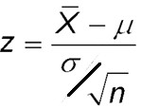



Z test: Known Variance-Small sample
The Concept
For a one sample test Z is defined as
When to be used?
Is the mean of the population known?
Is the standard deviation of the population known?
Does the population follow a
normal distribution
The z-test can be used to compare a sample mean to an accepted mean (one sample test) or to compare proportion of two groups
: The average of the sample
: The population mean
: The standard deviation
n: The sample size
This follows a standard normal distribution
i.e. a normal distribution with mean 0 and standard deviation 1, usually written as Z ~ N(0,1)
Hence it is governed by the properties of a normal distribution

Slide 21



t test: Unknown Variance-Small sample
The Concept
When to be used?
Define the null and alternate hypothesis
Is the mean of the population known?
Is the standard deviation of the population known?
Is the standard deviation of sample known?
Does the population follow a
normal distribution
The t-test can be used to compare a sample mean to an accepted mean or the compare means of two groups
Calculate the t-statistic for the data (t_{calc} )
Obtain a t-value for the significance level and d.f (t_{tab} )(from the table)
^{Is t}calc
^{> t}tab
Yes
No
Reject Null H_{o}
Fail to Reject H_{o}

Slide 22
Appendix

Slide 23
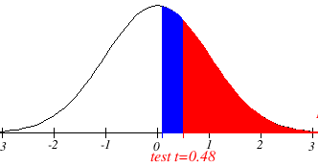
Z test : Illustration
Problem
 In a supermarket chain, in the year 2010 the average weekly sales was $485,000 with a standard deviation of 12,000 among stores with an area of about 40,000 sq. ft.
 In the first week of 2011, a random sample of 6 such stores is taken
 Examine if the average sales in all stores of this kind in the first week of 2011 has increase
Solution
 Assumptions: Distribution of sales in first week of 2011 in the chain is normal with mean µ and
s.d. 12,000
 𝐻₀: µ = 485,000; 𝐻_{𝐴}: µ > 485,000
 Under Ho: Z = (𝑋-485,000)/(12,000/√6) ~ N(0,1)
 Observed value of Z is (when 𝑋=485,098) 0.003334
 p-value = P(Z > 0.003334) = 0.4987 = 49.87%
 This is quite large and so we do not reject 𝐻₀
(For 5% Level of Significance the p-value has to be < 0.05)
See the impact of std. dev. and sample size !!
Store | Sales
A | 484,849
B | 480,594
C | 490,036
D | 487,710
E | 491,595
F | 475,803
P = 0.4987
Z = 0.003334

Slide 24
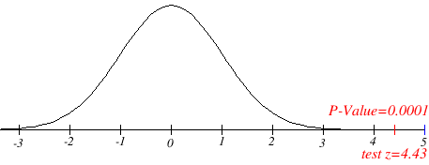
Z test : lets take a different case
Problem
 In a supermarket chain, in the year 2010 the average weekly sales was $485,000 with a standard deviation of 12,000 among stores with an area of about 40,000 sq. ft.
 In the first week of 2011, a random sample of 6 such stores is taken
 Examine if the average sales in all stores of this kind in the first week of 2011 has increased
Solution
 Assumptions: Distribution of sales in first week of 2011 in the chain is normal with mean µ and
s.d. 12,000
 𝐻₀: µ = 485,000; 𝐻_{𝐴}: µ > 485,000
 Under Ho: Z = (𝑋-485,000)/(12,000/√6) ~ N(0,1)
 Observed value of Z is (when 𝑋=506,764) 4.43
 p-value = P(Z > 4.43) <0.0001
 This is very small and so we do reject 𝐻₀
See the impact of std. dev. and sample size !!
Store | Sales
A | 514,849
B | 510,594
C | 500,036
D | 507,710
E | 511,595
F | 495,803

Slide 25
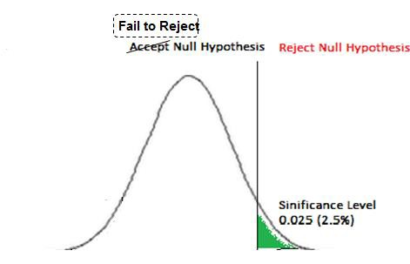
Building Blocks: Test statistic, Significance level....
Test Statistic
 A test statistic is a measure calculated from a sample of data. E.g. (Actual Cure – Expected Cure)
 The choice of a test statistic will depend on the hypothesis under question, population characteristic etc. and will be assumed to follow a pre-defined distribution
 Its value is used to decide whether or not the null hypothesis should be rejected in a
hypothesis test.
Significance Level
 Measure of how unlikely you want the results of the sample to be before you reject the null hypothesis
Test Statistics
(Expected – Actual)

Slide 26

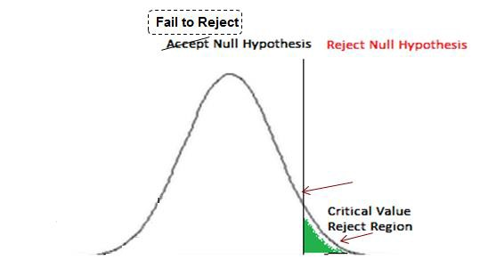
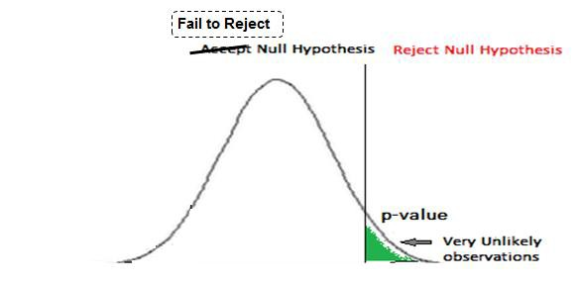
Building Blocks (contd.): ….Critical value and region, p-value
Critical Region
Set of values that present the most extreme evidence against the null hypothesis
The fewer people in the sample who are cured, the stronger the evidence there is against the claims
6
p-value
p-value, is the probability given the null hypothesis is true, that the observed value is as extreme or more extreme than the actual
Smaller p-value, stronger evidence to reject null hypothesis

Slide 27
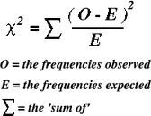
Chi square test: Test of frequency
The Concept
When to be used?
Are the variables categorical?
Is the sample size adequate and random?
Are the degrees of freedom
known?
 Chi square statistics uses the degree of freedom which is the number of values that are free to vary after restriction has been placed on the data
 For instance, if the sum of four numbers is required to be 50, then three variables can assume any value but the fourth variable should have a value so that the sum comes to 50 hence d.o.f is 3
The chi-square test is used to determine whether there is a significant difference between the expected frequencies and the observed frequencies in one or more categories

Slide 28
Chi square test: Illustration
A dice is rolled 36 times. The frequencies of the observed outputs are mentioned in the table
The finding that the frequencies differ does not mean that the die is not fair
To test whether the die is fair one has to conduct a significance test - the null hypothesis is that the die is fair
If the probability of this observed frequency distribution is sufficiently low (compared to significance level), then the null hypothesis that the die is fair can be rejected
Number on Dice
Observed Frequency
Expected Frequency
(O-E)²/E
1
8
6
0.667
2
5
6
0.167
3
9
6
1.500
4
2
6
2.667
∑ (O-E)²/E = 5.33
5
7
6
0.167
6
5
6
0.167

Slide 29
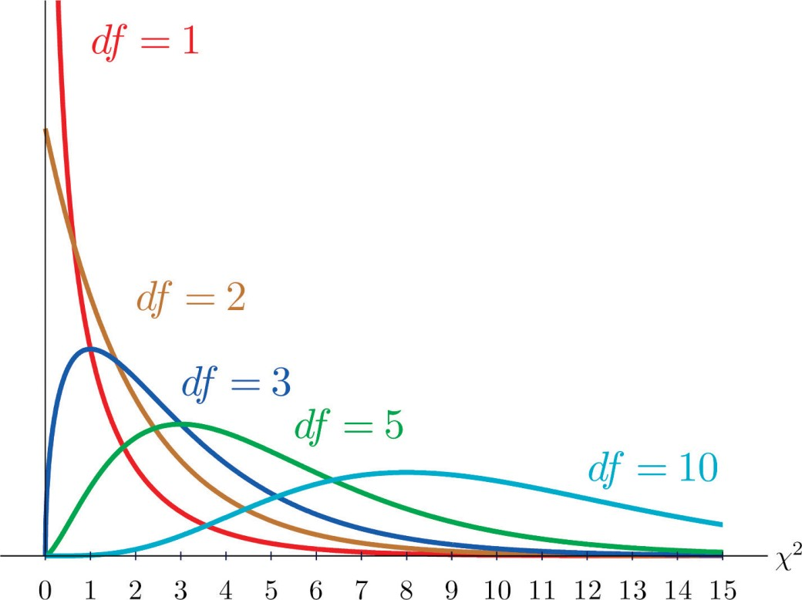
Chi square test: Illustration
Now that the degree of freedom is known (df = 6 – 1 = 5) and the value of chi-square has been calculated, the p-value has to be found out to get the significance level
For this purpose, we use a chi-square table (or a calculator)
In our case, when the 𝑋2 = 5.33 (df=5) the p-value associated with it is 0.377 (which is more than the level of significance) hence we fail to reject the null hypothesis
As the df increases, the chi square distribution takes the shape of normal distribution

Slide 30
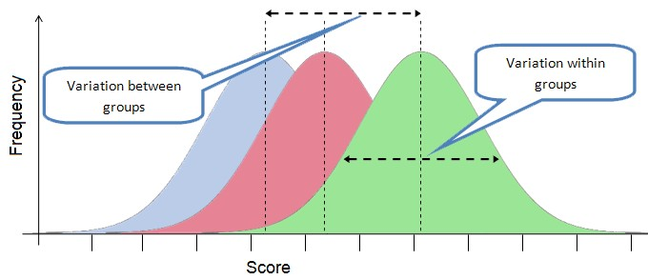
Analysis of Variance : ANOVA
It is a way to test the hypothesis that there is not much difference between groups on some variable / treatment
In the typical application of ANOVA, the null hypothesis is that all groups are simply random samples of the same population hence all treatments have the same effect (perhaps none). Rejecting the null hypothesis implies that different treatments result in altered effects
Consider the three graphs. They almost are the same and it is hard to tell the difference in their means just by looking

Slide 31
Visualizing the variability and variance within a group and
amongst groups
To distinguish between these groups, the variability amongst the groups must be greater than that within the groups

Slide 32






Calculation of ANOVA depends on the number of groups being
considered
Source
Degree of Variance F -statistic
freedom
Between groups
K-1 (K is the number of groups)
^{SS}bet
(Sum of squares between
samples)
( SS_{bet} / k-1 ) =
^{MS}bet
MS_{bet} (Variance between samples)
Within groups
N-K (N is the total number of observations across all the groups)
SS_{W} (Sum of squares within samples)
F=MS_{bet} / MS_{w}
( SS_{W} / N-k ) = MS_{w}
MS_{w} (Variance within samples)

Slide 33
The F statistics generated gives the p-value based on the characteristics of F distribution
 This F-statistic can be compared with the tabulated values of F –distribution with (k-1) and (N-
k) degrees of freedom
 The significance level tells whether to accept or reject the null hypothesis
 When we have only two groups to consider, a t-test can be used to compare the difference
 However for more than two groups, conducting multiple t-tests (taking two at time) is not recommended as it can severely inflate Type 1 errors
 Two important terms while doing ANOVA are:
Factor: A characteristic under consideration e.g. flavor, thought to influence the measured observation
Levels: A value of the factor e.g. chocolate, lemon etc.
 One way ANOVA is a test to study effects of more than one levels of a single factor so the test of hypotheses H₀: µ_{i}= µ where i = 1,2,3,4,….k (µ_{i} is the mean of population for the different levels of i)

